Slide 1
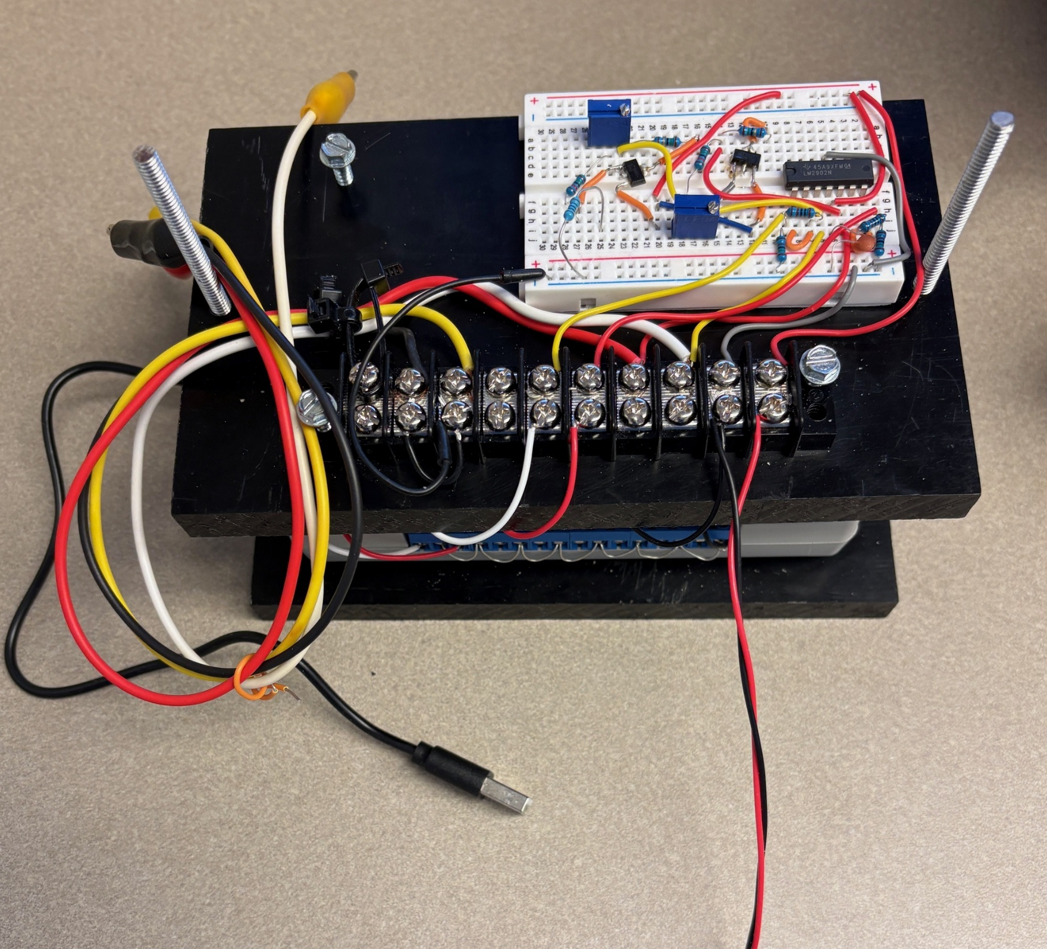
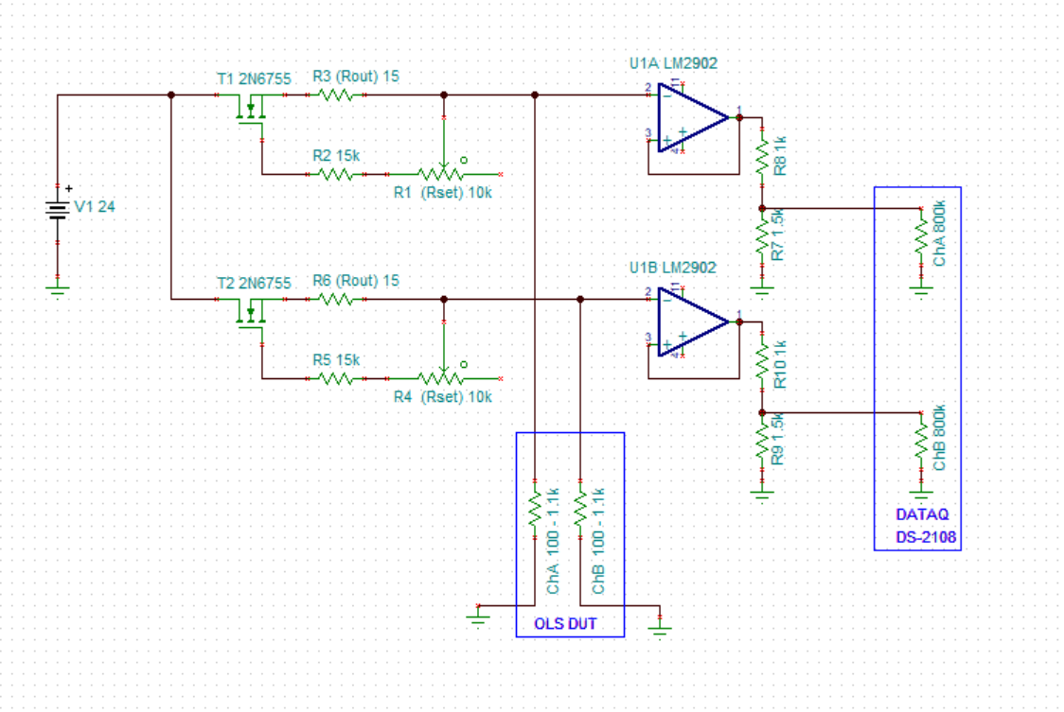

Interface
Circuit
Clip to
OLS DUT
DATAQ
DI-2108
To 24Vdc
To USB Hub
R6
R1
R3
R5
1
2
U3
R2
1
2
3
U1A
U1B
3
1
U2
R10
R4
R8
R7
R9

Slide 2
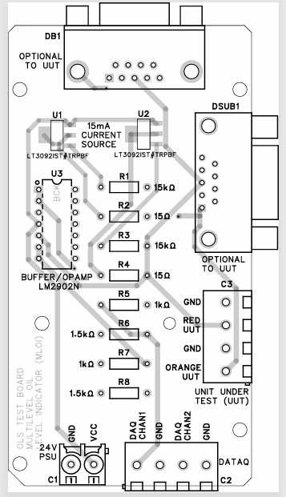
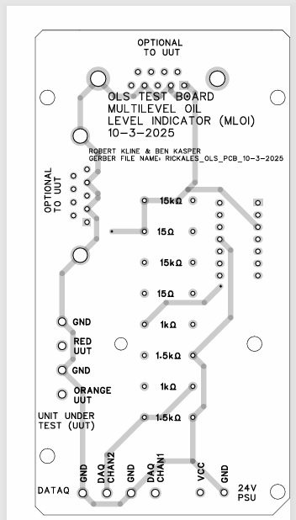
Top View
Bottom View

Slide 3
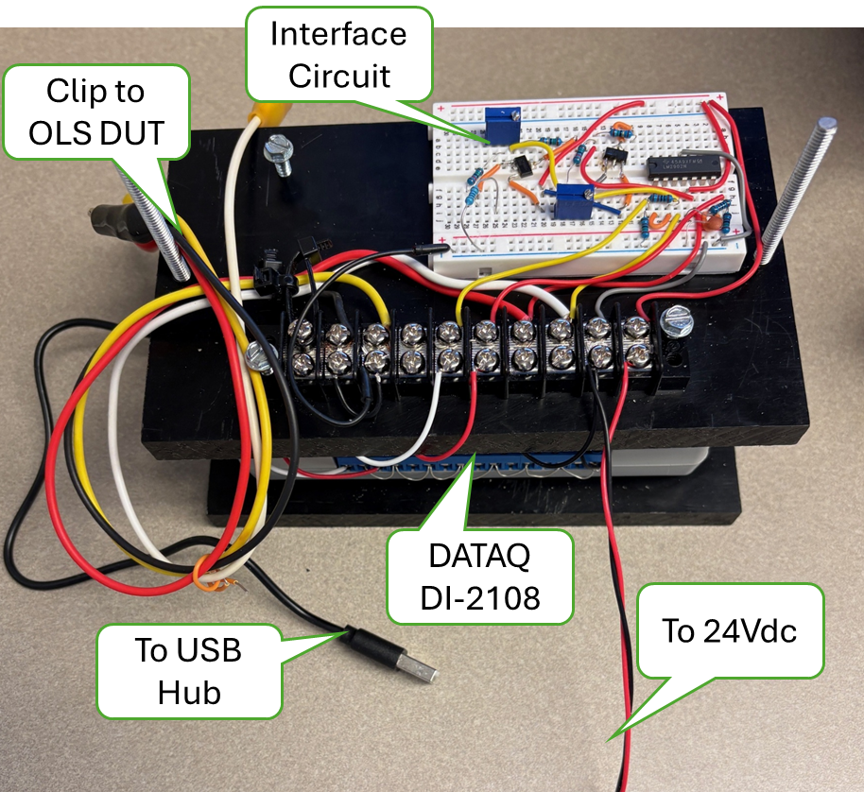
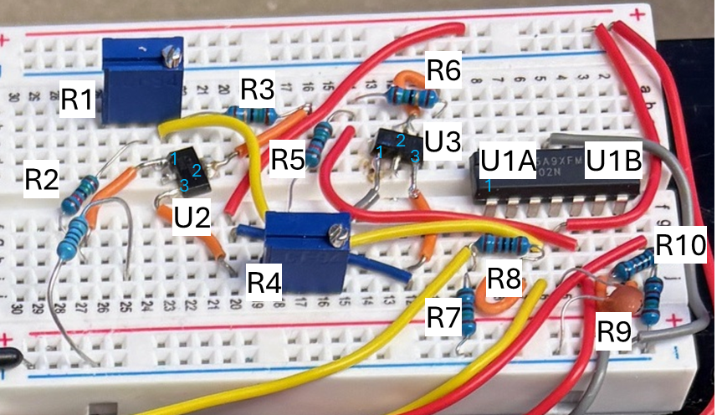
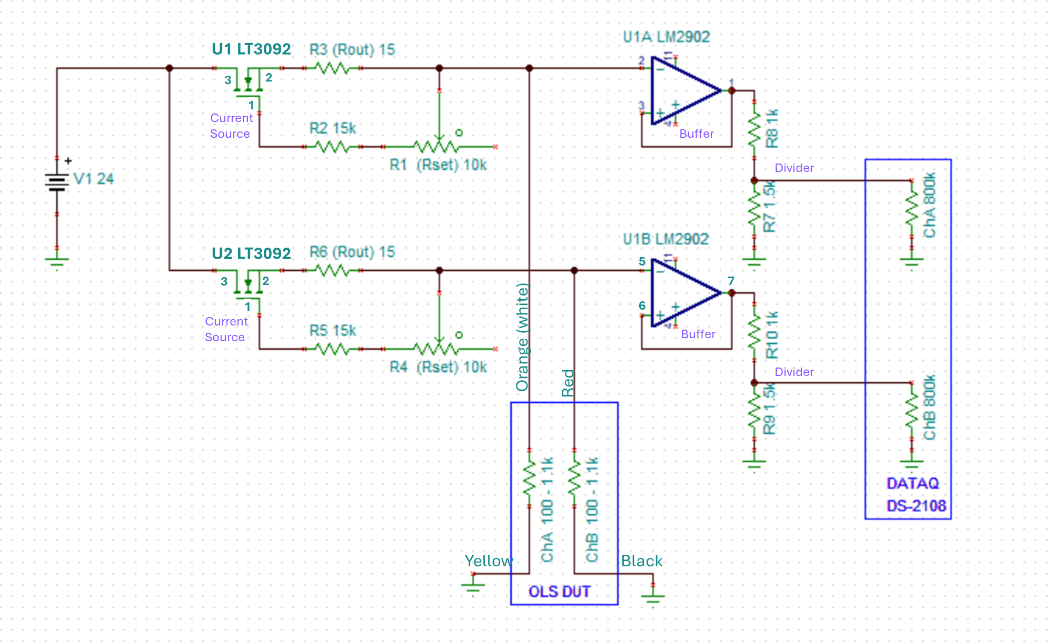
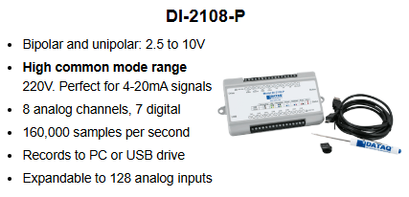
DC Accuracy +/-5mV @10V

Slide 4
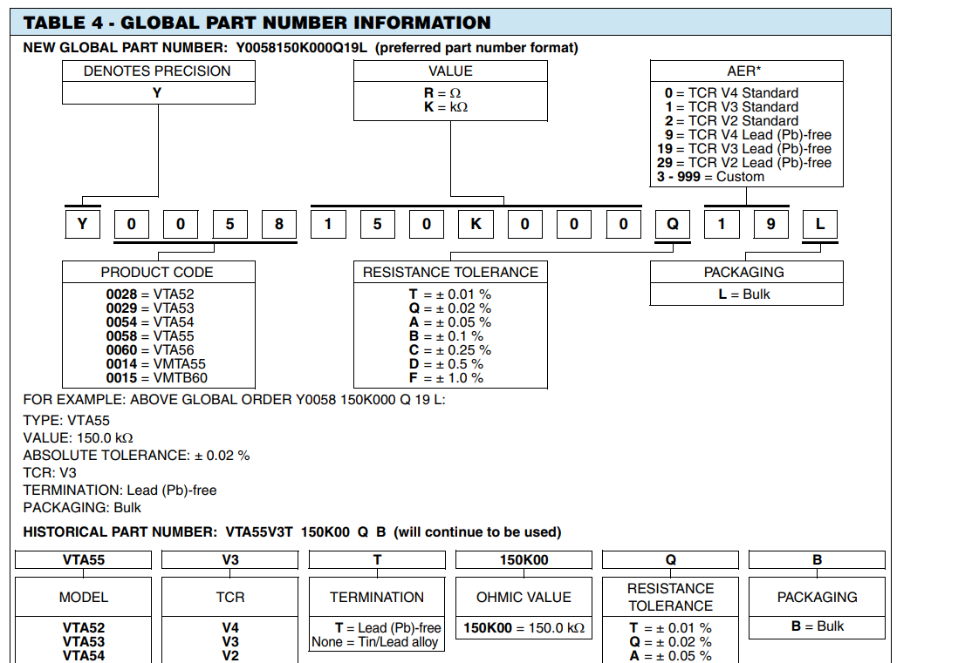
Vishay
VTA52 through 56, VMTA55, VMTB60
Foil Resistors
100Ω 0.01% .5W 300V : Y 0 0 2 8 1 0 0 R 0 0 0 T 0 2 L
1KΩ 0.01% .5W 300V : Y 0 0 2 8 0 0 1 K 0 0 0 T 0 2 L

